Slide 1
CS 5330 Programming Assignment 2
Grania Machado
machado.g@northeastern.edu
machado.g
NUID: 001517781

Slide 2
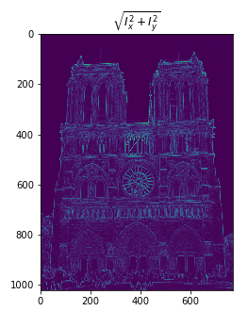
Part 1: Harris corner detector
[Which areas have highest magnitude? Why?]
Corners have the highest magnitude in the image. An edge is a sudden change in image brightness and a corner is a junction of two such edges. Corners are points whose local neighborhood stands on two opposing and dominant edge directions. The important features in an image are its corners, which are generally referred to as interest points that remain unchanged despite translation, rotation, and illumination. For a corner region, there is a significant gradient change in all directions.

Slide 3
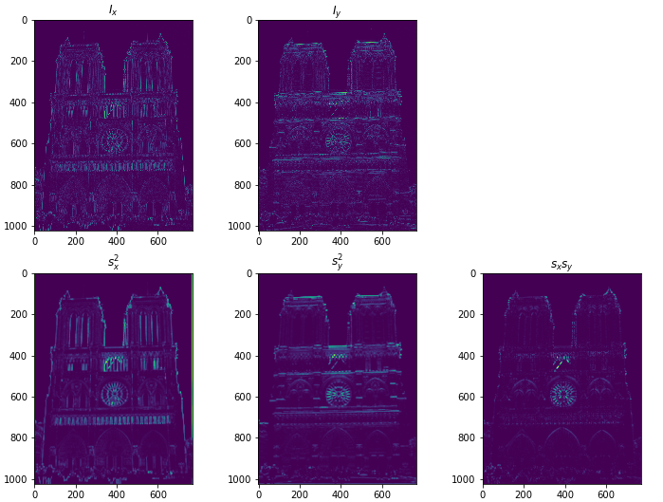
Part 1: Harris corner detector
[insert visualization of I_{x}, I_{y}, s_{x}², s_{y}², s_{x}s_{y} for Notre Dame image pair from pa2.ipynb here]

Slide 4
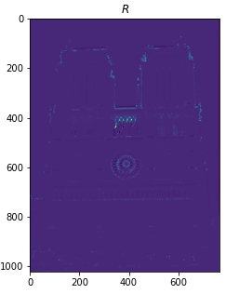
Part 1: Harris corner detector
[insert visualization of corner response map of Notre Dame image from pa2.ipynb here]
[Are gradient features invariant to both additive shifts (brightness) and multiplicative gain (contrast)? Why or why not? See Szeliski Figure 3.2]
As gradient values are computed from pixel differences, a brightness change that adds a constant to each pixel will not affect their gradient values. Any change in image contrast in which each pixel value is multiplied by a constant will also multiply gradients by that constant. Hence, gradient features are invariant to additive shifts (brightness) but not invariant to multiplicative gain (contrast) so this change can be cancelled by vector normalization.

Slide 5
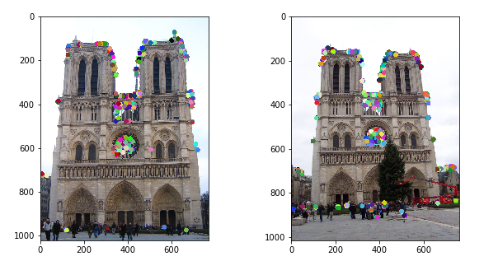
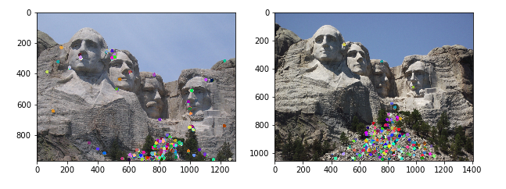
Part 1: Harris corner detector
[insert visualization of Notre Dame interest points from pa2.ipynb here]
[insert visualization of Mt. Rushmore interest points from pa2.ipynb here]

Slide 6
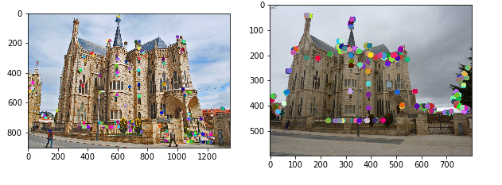
Part 1: Harris corner detector
[insert visualization of Gaudi interest points from pa2.ipynb here]
[What are the advantages and disadvantages of using maxpooling for non-maximum suppression (NMS)?]
Advantages : Through max-pooling, a variable number of pairs can be reduced to a fixed-size representation. For each detection, pairwise computations are performed independently. Max pooling gives a more accurate feature space.
Disadvantages : Sensitivity to hyperparameters like kernel size, stride. Running model on lower stride often takes longer execution times, hence expensive. Tuning of hyperparameters is a time-consuming process.

Slide 7
Part 1: Harris corner detector
[What is your intuition behind what makes the Harris corner detector effective?]
Harris corner detector is rotation, scale and illumination variation independent. Harris Corner Detection detects corners since corners are translation invariant and rotation invariant, while being distinguishable, in contrast to edges and flat regions. These properties make corners good candidates for feature detection.
First it computes the horizontal and vertical derivatives (edges) of gray scaled version of the image, then it performs cross correlation on these edge images to highlight corners, and then it performs non-maximum suppression to get rid of the edge features, thus giving more accurate features for image matching.

Slide 8
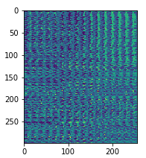
Part 2: Normalized patch feature descriptor
[insert visualization of normalized patch descriptor from pa2.ipynb here]
[Why aren't normalized patches a very good descriptor?]
Patches with similar content should have similar descriptors. However, normalized patches are less sensitive to absolute intensity values. Additionally, very small errors in rotation, scale, view-point, and illumination can affect interest points matching score significantly. They are computationally expensive as it needs to unwrap every single patch. Low frequency filtering and absorption of localization errors are other reasons why normalized matches aren’t good descriptor.

Slide 9
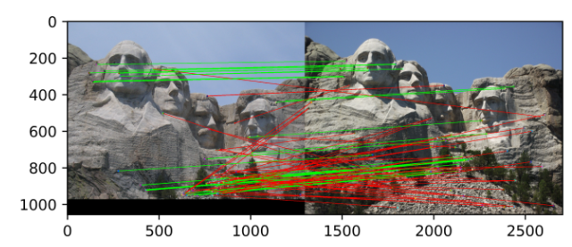
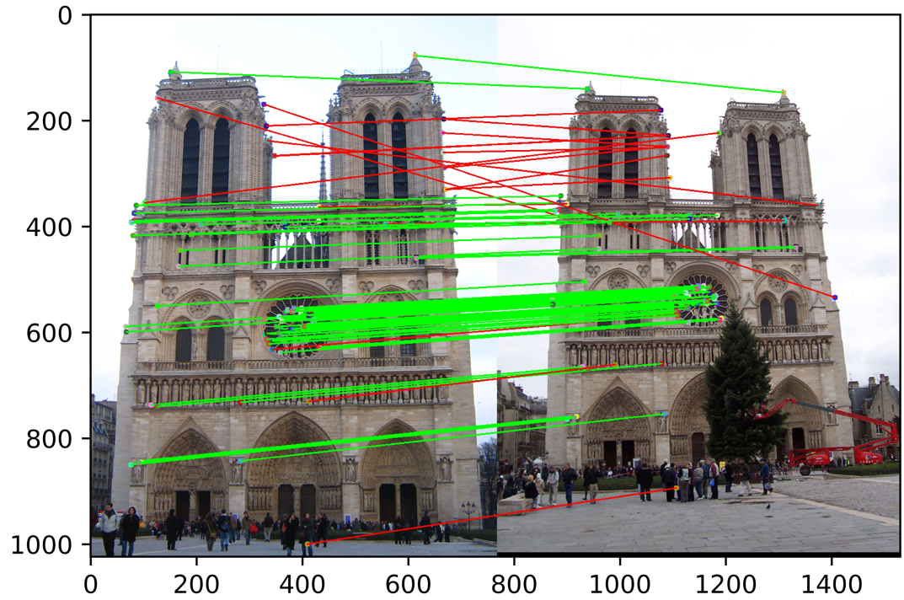
Part 3: Feature matching
[insert visualization of matches (with green/red lines for correct/incorrect correspondences) for Notre Dame image pair from pa2.ipynb here]
# matches (out of 100): 78
Accuracy: 0.80
[insert visualization of matches for Mt. Rushmore image pair from pa2.ipynb here]
# matches: 67
Accuracy: 0.43

Slide 10
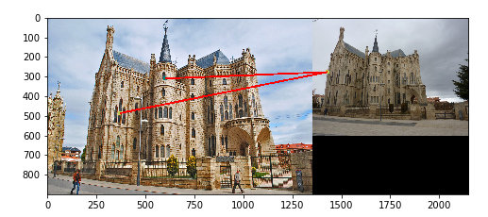
Part 3: Feature matching
[insert visualization of matches for Gaudi image pair from pa2.ipynb here]
# matches: 4
Accuracy: 0.0
[Describe your implementation of feature matching here]
In order to match the key points of the first image to the key points of the second image, the distance between each of the feature vectors created for each key point is calculated. The distances are the then sorted, and the two least distances are taken and compared. The ratio of the two minimum distances between two points in the second image is computed, then checked to determine if it exceeds a specified threshold, then the key point is considered valid.

Slide 11
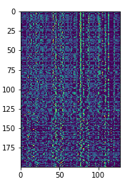
Part 4: SIFT feature descriptor
[insert visualization of SIFT feature descriptor from pa2.ipynb here]
[insert visualization of matches (with green/red lines for correct/incorrect correspondences) for Notre Dame image pair from pa2.ipynb here]
# matches (out of 100): 83
Accuracy: 81

Slide 12
Part 4: SIFT feature descriptor
[insert visualization of matches for Mt. Rushmore image pair from pa2.ipynb here]
# matches: 87
Accuracy: 0.75
[insert visualization of matches for Gaudiimage pair from pa2.ipynb here]
# matches: 2
Accuracy: 0.0

Slide 13
Part 4: SIFT feature descriptor
[Describe your implementation of SIFT feature descriptors here]
To characterize each key point, a 3-D spatial histogram is created by the SIFT feature descriptor. Each key point is characterized by a 128-dimensional feature vector. Firstly, a 16X16 patch is taken around the key point which is further divided into 16 4X4 patches. For each 4X4 patch, an 8-dimensional feature vector is created which considers the direction and orientation of each pixel in the patch. The 16 4X4 patches generate 8-dimensional feature vectors which are concatenated together to generate a 128-dimensional feature vector for each key point detected.
[Why are SIFT features better descriptors than the normalized patches?]
SIFT can generate large number of features that densely cover the image over the full range scales and orientations. Individual feature extracted by SIFT has distinctive descriptor, which allows single feature to find its probability in a large database of features.

Slide 14
Conclusion
[Why aren't our version of SIFT features rotation- or scale-invariant? What would you have to do to make them so?]
The feature vector uses gradient orientations. If we rotate the image, all gradient orientations also change. To achieve rotation independence, the keypoint’s rotation is subtracted from each orientation. Thus, each gradient orientation is relative to the keypoint’s orientation. We create SIFT internal representations of the original image to ensure scale invariance. This is done by generating a scale space. The Laplacian of Gaussian i.e. LoG Approximation is great for finding interesting points (or key points) in an image. If we threshold numbers that are big, we can achieve illumination independence. So, any number greater than threshold is reduced to threshold value. This resultant feature vector is normalized again. And now you have an illumination independent feature vector.

